Slide 1
Flow Control
It is often desirable to control when statements are executed
Sometimes, statements should be skipped altogether
Other times, the same statement should be executed repeatedly
Can be subdivided into conditional statements and loop statements
Conditional Statements:
IF
ELSE
ELSE IF
Looping Statements:
FOR
WHILE
DO WHILE

Slide 2
6 – Loop statements

Slide 3
Looping Statements
FOR:
runs a block of code a specified number of times
WHILE:
repeatedly runs a block of code while a condition is true
DO WHILE:
runs a block of code once then repeats while a condition is true

Slide 4
FOR statements
for (initialise; condition; operation) {
do this;
}
Indentation inside conditional statements & loops is considered good practice
Statements must be enclose by curly braces
FOR statements consist of four components:
Initialise: initialise a variable – typically this variable is used in the loop
Condition: continue executing the loop while this statement is true
Operate: perform some operation at the end of each loop
Print numbers from 0 to 9:
for (count = 0; count < 10; count = count + 1) {
print(count);
}
i = 0;
for ( ; i < 10; ) {
print(i);
i = i + 1;
}

Slide 5
Increment operator
++
for (count = 0; count < 10; count = count + 1) {
print(count);
}
for (count = 0; count < 10; count++) {
print(count);
}

Slide 6
WHILE statements
while(this statement is true){
do this;
}
Essentially a simplified FOR statement
Print numbers from 0 to 9:
i = 0;
while (i < 10) {
print(i);
i++;
}

Slide 7
DO-WHILE statements
do {
do this;
} while (this statement is true);
Essentially a reversed WHILE statement
Print numbers from 0 to 9:
i = 0;
do {
print(i);
i++;
} while (i < 10);

Slide 8
Nesting loops
Any number of conditional and loop statements can be “nested” within each other
denom = 3;
for(i = 1; i <= 30; i++){
if(i % denom == 0){
divisible = "is";
} else {
divisible = "is not";
} print(i + " " + divisible + " divisible by " + denom);
}
if(this is true){
if(this is true){
if(this is true){
while(this is true){
if(this is true){
for(initialise; condition; increment){
if(this is true){
do this;
} else {
if(this is true){
do this;
}
}
}
} while (this is true){
do this;
}
}
}
} else {
do this;
}
}
However, excessive nesting is considered poor coding practice

Slide 9
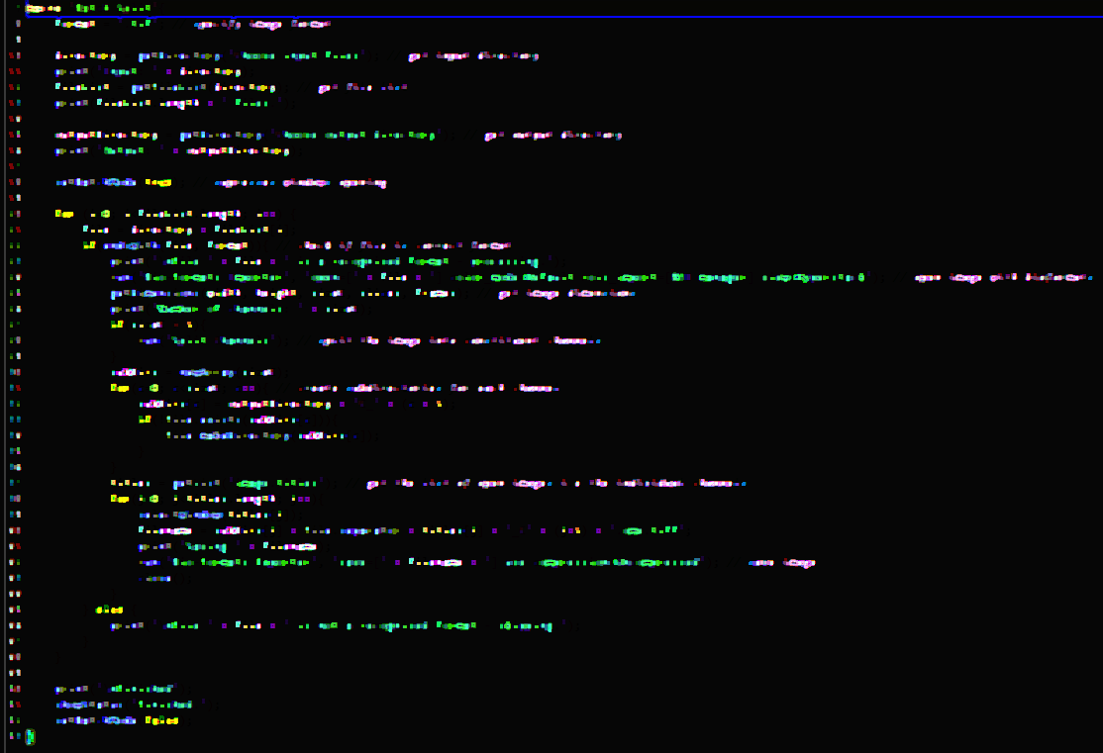
DEMO 8 – Loop Statements
Open Snippets/08_Loop_Statements.ijm
width

Slide 10
Problem 2 – Loop Statements
Open Problems/2_Loops.ijm
Two points for each problem solved
width

Slide 11
7 – Conditional statements

Slide 12
Conditional Statements
IF:
runs a block of code if a specified condition is true
ELSE:
combines with IF statement
runs a block of code if the condition specified in the IF statement is not true
ELSE IF:
combines with IF statement
runs a block of code if the condition specified in the IF statement is not true but a second specified condition is true

Slide 13
IF statements
if (this statement is true) {
do this;
}
N = nImages(); // get number of open images
if (N > 0) {
title = getTitle(); // get the title of the active image
print("title: " + title); // print the image title
}
Indentation inside conditional statements & loops is considered good practice

Slide 14
IF-ELSE statements
if (this statement is true) {
do this;
} else {
do this;
}
if (nImages() == 0){
print("No images are open - exiting");
} else {
print("Processing image " + getTitle());
}

Slide 15
IF-ELSE IF statements
if (this statement is true) {
do this;
} else if(this statement is true){
do this;
} else if(this statement is true){
do this;
} else{
do this;
}
if (nImages() == 0){
print("No images are open - exiting");
} else if (nImages() < 4) {
print("Processing image " + getTitle());
} else {
print("Too many images open - aborting!");
}

Slide 16
DEMO 9 – Conditional Statements
Open Snippets/09_Conditional_Statements.ijm
width

Slide 17
Problem 3 – Conditional Statements
Open Problems/3_Conditional_Statements.ijm
Two points for each problem solved
width

Slide 18
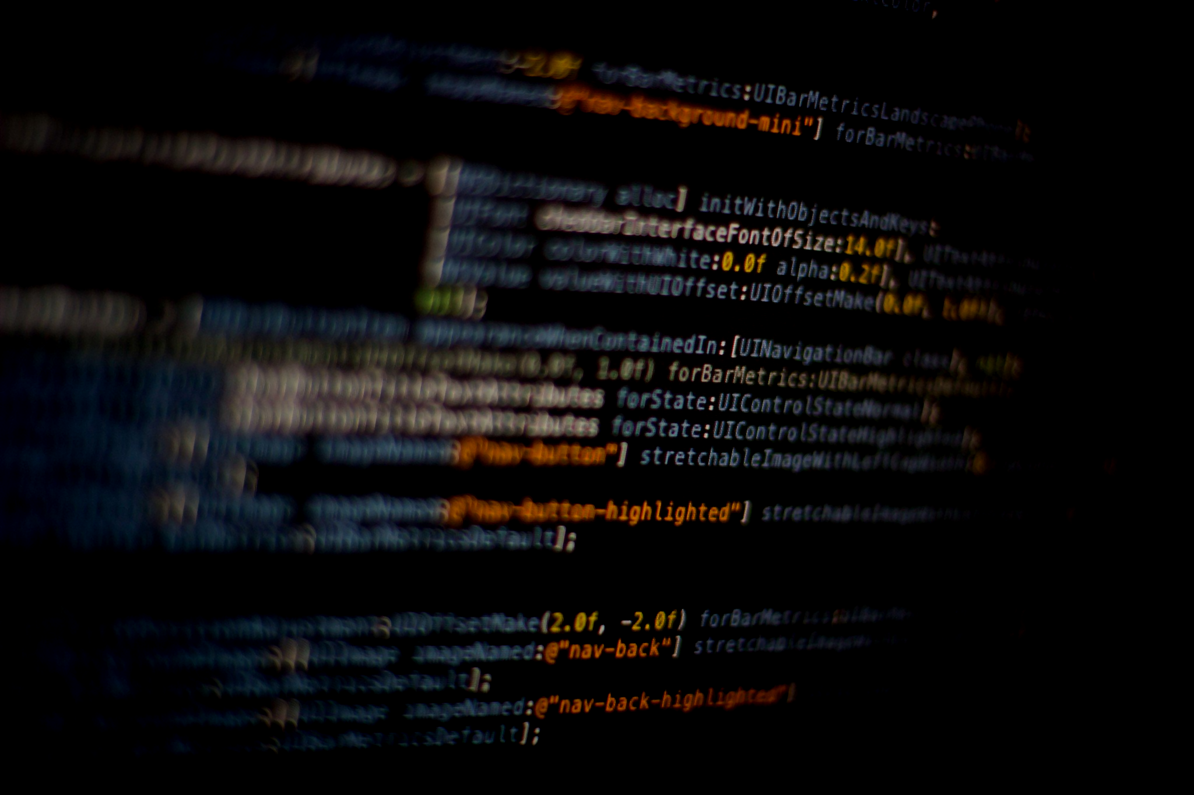
5 – Using Built-In Functions

Slide 19
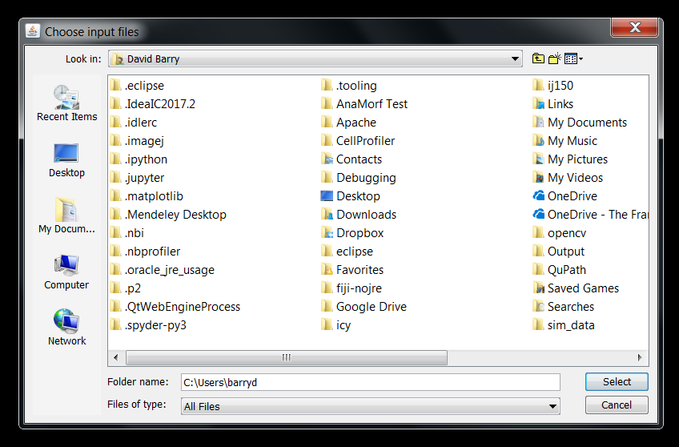
The Get Directory function
getDirectory(string)
Displays a “choose directory” dialog and returns the selected directory.
Returns an “empty” string if the specified directory is not found.

Slide 20
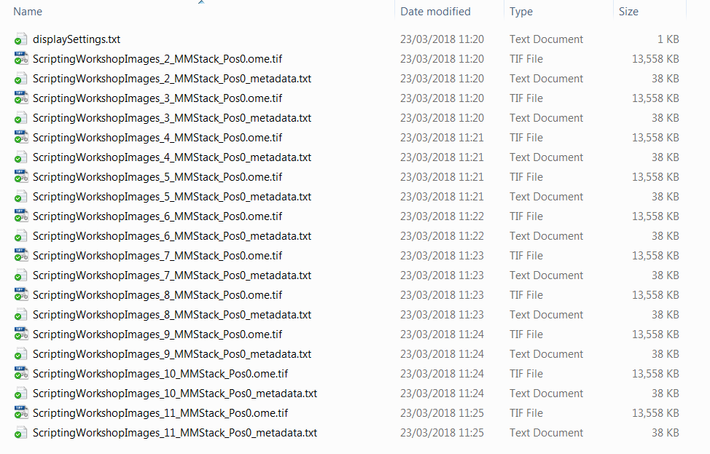
The Get File List function
getFileList(directory)
Returns a list of the file names in the specified directory

Slide 21
Problem 1 – Variables
Open Problems/1_Variables.ijm
One point for each problem solved
width

Slide 22
The Set Batch Mode function
setBatchMode(arg)
Controls whether images are visible or hidden during macro execution.
Why is this useful?
Interacting with a window mid-macro can cause errors
Batch mode macros run up to 20x faster.
Load pixel data
Create canvas to display image
Create window to display canvas
Display window, monitor user input

Slide 23
DEMO 7 – Batch Mode
Open Snippets/07_Batch_Mode.ijm
width

Slide 24
The ENDS WITH function
endsWith(string, suffix)
Returns true if string ends with suffix, otherwise returns false;
endsWith(file, format)
Check whether the variable file ends with specified suffix
In other words, check if the file is of the specified file format
Processing the wrong file type will likely produce an error
Good example of error checking – never assume the user knows what they are doing!

Slide 25
8 – The RUN Command

Slide 26
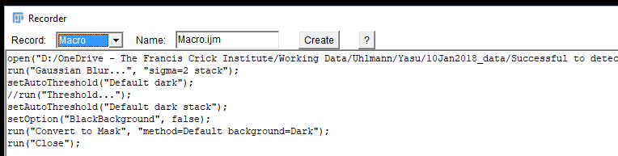
The Run command
run("command", "options")
Executes an ImageJ menu command.
Options argument contains values automatically entered into dialog boxes.
Provides access to most menu commands

Slide 27
Run command OPTIONS
run("command", "options");
run("Set Measurements...", "area shape display redirect=None decimal=3");
…and each MUST be separated by a space.
Each of these represents something selected in the dialog box…

Slide 28
But what if I need to specify an option that contains spaces?
run("Bio-Formats Importer", "open=[D:/OneDrive - The Francis Crick Institute/Training/Scripting Workshop/Scripting Workshop Images/ScriptingWorkshopImages_2_MMStack_Pos0.ome.tif]");
run("Bio-Formats Importer", "open=D:/OneDrive - The Francis Crick Institute/Training/Scripting Workshop/Scripting Workshop Images/ScriptingWorkshopImages_2_MMStack_Pos0.ome.tif");
Square brackets tell FIJI to ignore spaces between them

Slide 29
DEMO 10 – The Run Statement
Open Snippets/10_Run_Statement.ijm
width

Slide 30
Problem 4 – The RUN Statement
Open Problems/4_The_Run_Statement.ijm
Four points for solving the problem
width

Slide 31
9 – Manipulating files

Slide 32
File Functions
Get information about a file
Read or write a text file
Create a directory
Delete, rename or move a file or directory.
File.exists(path)
Returns true if the specified file exists.
File.makeDirectory(path)
Creates a directory.
File.separator
Returns the file name separator character ("/" or "\").

Slide 33
DEMO 11 – File Functions
Open Snippets/11_File_Functions.ijm
width

Slide 34
10 – Manipulating images

Slide 35
Let’s do something with images!
We have a script that will open images and create directories
Now we need to do something with the images
Q: How do we direct FIJI to a particular image?
A: We need to know the image names
getList("image.titles")
Returns a list (array) of image window titles.
getList("window.titles")
Returns a list (array) of non-image window titles.

Slide 36
Before doing anything with an image, we need to tell FIJI which image we want to work on…
selectWindow("name")
Activates the window with the title "name".

Slide 37
Close Function
close()
Closes the active image.
close(pattern)
Closes windows whose title matches 'pattern'.
For example, close("Histo*") would close all histogram windows.
Use close("*") to close all image windows.

Slide 38
12 – Writing your own functions

Slide 39
What is a function?
Can be thought of as a self-contained script
A function is a block of code that can be passed variables and/or return a value
function myFunction(arg1, arg2, arg3) {
Add arg1 and arg2 together;
Divide result by arg3;
Print status;
return result;
}
Function name
Function parameters
function sum(a, b) {
return a + b;
}
s = sum(1, 2);
print(s); // output is 3
a and b are assigned the values 1 and 2

Slide 40
Functions don’t have to take arguments or return anything
function hello() {
print("Hello");
}
hello(); // prints “Hello” to the log window
Other names include…
methods (Java)
subroutines (older, low-level assembly languages)

Slide 41
DEMO 12 – Functions
Open Snippets/12_Functions.ijm
width

Slide 42
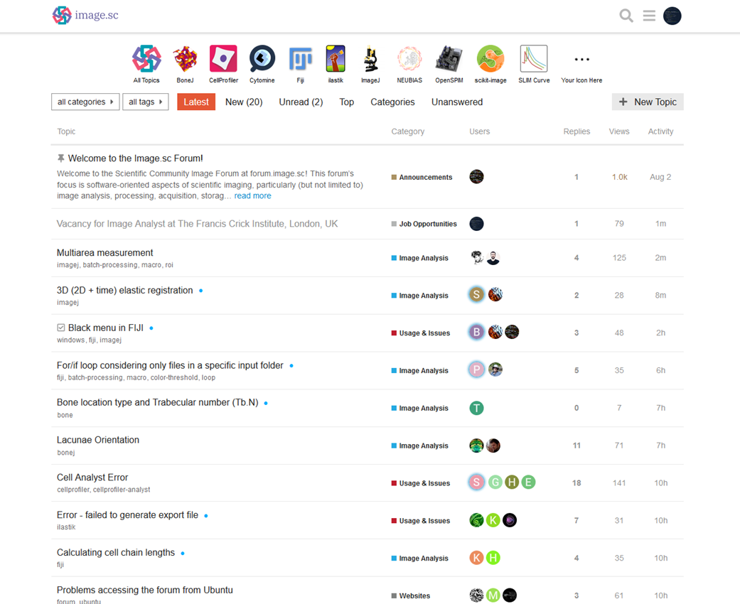

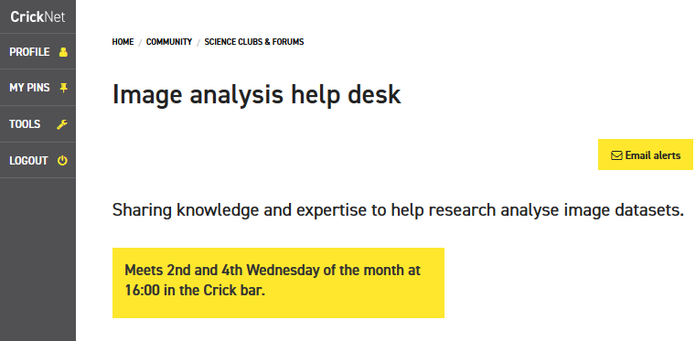


Thanks for sticking around
david.barry@crick.ac.uk
SW302

Slide 43
Useful references
https://doi.org/10.1371/journal.pcbi.1007433
https://doi.org/10.1371/journal.pcbi.1005871

